Slide 1

KICKSTARTER SUCCESS STORIES
PROJECTS FOR THE MARKETING TEAM’S FOCUS
Prepared by: Kalekidan Abera, Anne Bikele Matanga, Armand Sindoni, Woldie Wubale, Janet Zimmer

Slide 2
The money makers
Projects on which to focus: those that have a balance of all these characteristics:
Success rate
High pledge amounts (high percent funded), including those where pledges greatly exceed the goal amount set
Number of backers
All characteristics must be used to identify a project that is a projected money-maker
Notes:
Success drives income for Kickstarter because failed projects result in no money collected for creator or in Kickstarter fees.
Successful projects are those that have set and met or exceeded the goal amounts.
In addition, a project that is successful and for which the goal has been exceeded by pledges, can be considered a money-maker, as well.
So the money makers are those types of projects that are successful, and have average pledge amounts (percent funded) above the average for other projects. The number of backers for a project also plays a role in generating pledge totals
This may or may not be related to the goals set for the project by the creator.
We will look at these characteristics from two viewpoints: those MAIN CATEGORIES and the best SUB-CATEGORIES (whether or not they are in the main categories selected.)

Slide 3
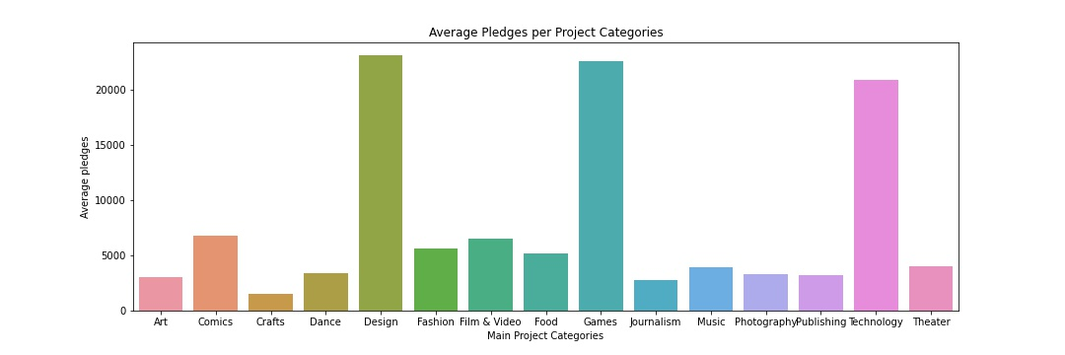
THE MONEY MAKERS (by main category)
Types of projects that generate the highest results (and 5% fees if successful)
Design
Games
Technology
$23,133
$22,622
$20,898
Average Pledged across all Categories - $8,576
Notes:
In the main categories of projects, those projects that receive the largest financial backing stand out from the rest. Larger pledge support also means a larger income for Kickstarter, based on the 5% fee generated by completed projects. Of the three projects that, on average, generate the greatest number of pledges, the Design category, with and average pledge amount of $23,133 leads all project types. Games comes in with $22,622. And Technology with $$20,898. We will look at whether these same three project categories also rank highest in success rate (meaning the money is actually gathered and the fees paid).

Slide 4
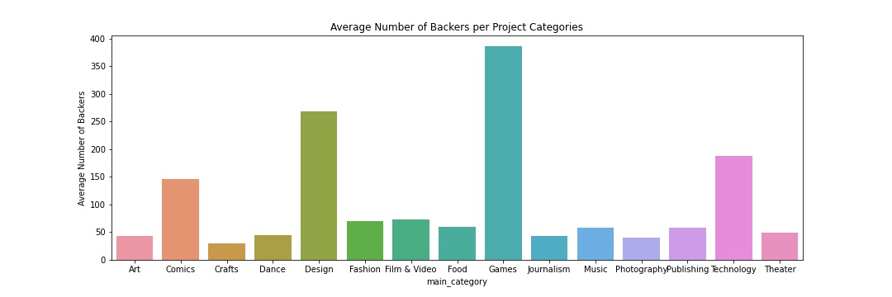
Most popular category of projects (Based on AVERAGE number of backers)
Games
Design
Technology
386
269
187
Average Number of Backers across all Categories - 112
Notes:
The Games category attracts the greatest average number of backers . Since Games comes in second to Design in terms of pledges, it might be assumed that the average amount pledged for Games is slightly less than the average amount pledged for items in the Design category.

Slide 5
THE TOP 3 MONEY-MAKERS in the Sub-Categories
Highest Average Pledges:
Camera Equipment - $71,127
3D Printing - $70,322
Gaming Hardware - $69,562
Largest Average Number of Backers – most popular:
Chiptunes – 498
Video Games – 483
Table Top Games - 478
Notes:
In the sub-categories, the most profitable (average pledge amount) is Camera Equipment. The most popular is Chiptunes (synthesized electronic music produced by the sound chips of vintage computers, video game consoles, and arcade machines, as well as with other methods such as emulation. Definitions.net)

Slide 6
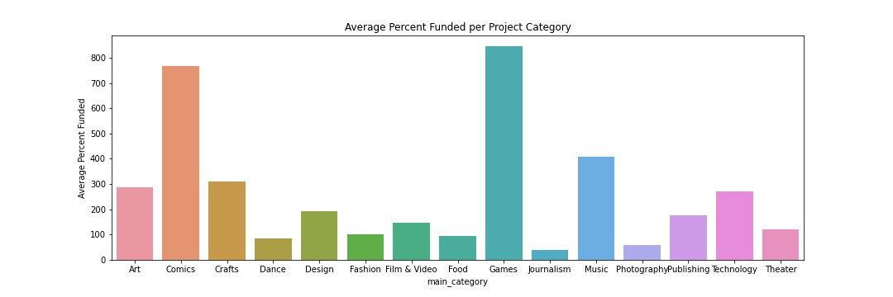
Projects that received more pledged amounts than goals set
Notes:
These projects were over-pledged. In other words, the pledged amounts were greater than the goal set by the creator. The over-subscribed project categories (e.g. Games) also had the highest number of backers.
Again, this is not to assert that any of these projects were successful.

Slide 7
Success is as important as pledged amounts
Which Main Categories have the highest average success rates
Dance – 66%
Theater – 64%
Comics – 56%
Which Sub-Categories have the highest average success rate?
Chiptunes – 81%
Residences – 71%
Dance – 70%
Which Main Categories have the highest average pledge amounts?
Design (60% failure rate)
Games (58% failure rate)
Technology (76% failure rate)
Which Sub-Categories have the highest average pledge amounts:
Camera Equipment (45% failure rate)
3D Printing (58% failure rate)
Gaming Hardware (71% failure rate)
Notes:
It is not just the average pledge amount or the average number of backers which guarantees that a project will be successful (that is, meets or exceed its goals). By simply looking at the top Categories in pledge amounts, one can be deceived because those same projects may have poor success results.

Slide 8
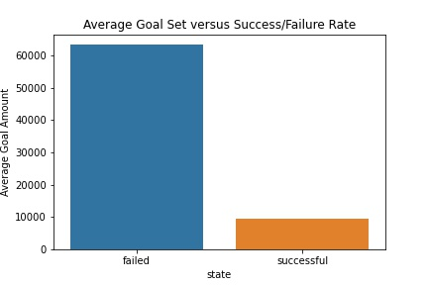
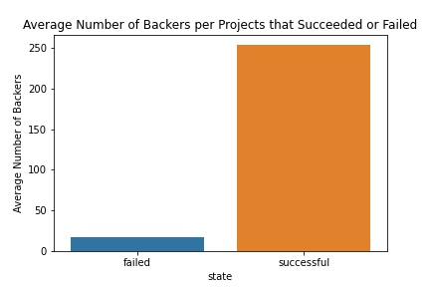
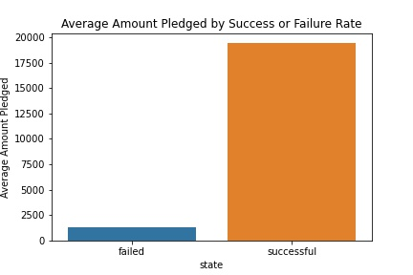
BASIS FOR PREDICTED SUCCESS/FAILURE OF A CAMPAIGN
Success/failure by Goal Amount
Success/Failure by number of Backers
Success/Failure by Pledged Amount
Notes:
Goals that are set too high fail more often and goals that are smaller and more easily met. The lower the funding goal, the more successful. The goal for a successful campaign is 9,623 dollars, for a failed campaign, 63,432 dollars.
The greater the amount pledged, the more often the project is a success. This also accounts for projects where the goal was set very low and the pledged amount far exceeds the goal.
Associated with amount pledged is the number of backers.

Slide 9
WHAT MAKES FOR A SUCCESSFUL CAMPAIGN? Look for projects that are successful and profitable
Reach out to a large number of backers (including the Forward Funders)
Set a reasonable goal amount
Set a length of approximately 30 days to completion and complete the campaign on time
As a last option, chose a main category that is popular and a sub-category that is popular
Notes:
Choosing a category or project that is in a popular group is not the first decision to be made. If one has an idea that has merit or means a great deal to the creator, that dream should be pursued. Focus on the first step listed here.

